Slide 1
Game Recommendation Engine
By-
Rajat Narang 334/CO/12
Sushant Magu 3__/CO/12
Saransh Sawhney 3__/CO/12

Slide 2
Features Included
Personalized game recommendations based on the rating / purchase patterns of similar users
Profile with XBOX 360 achievements, rating system, custom signup and login components
Custom comments system, store purchases, YouTube trailer previews

Slide 3
Infrastructure
node.js - application server
express - web framework for node.js
mongoose - mongodb object document mapper
bcrypt - cryptography library
redis-store - storing sessions in redis database
request - used for initiating requests to parse the website
jsdom - used to parse a website
underscore.js - utility functions for javascript
underscore.strin - utility functions for javaScript strings
emailjs = sends e-mail via a designated SMTP server

Slide 4
Tools
JetBrains IntelliJ IDEA 12
GitHub

Slide 5
Design and Front-end
Bootstrap - css framework by Twitter (http://twiter.github.com/bootstrap)
Jade - server-side templating language (http://jade-lang.com)
Credit Card Icons - (http://www.smashingmagazine.com/2010/10/21/free-png-credit-card-debit-card-and-payment-icons-set-18-icons/)
jQuery Raty - star ratings (http://wbotelhos.com/raty)
Game information - parsed from Gamespot.com and Amazon.com
jquery.validate - client-side input validation (http://bassistance.de/jquery-plugins/jquery-plugin-validation)
jquery.meow - javascript notifications when rating a game (http://zacstewart.com/projects/meow.html)
humane.js - javascript notifications when buying a game (http://wavded.github.com/humane-js)

Slide 6
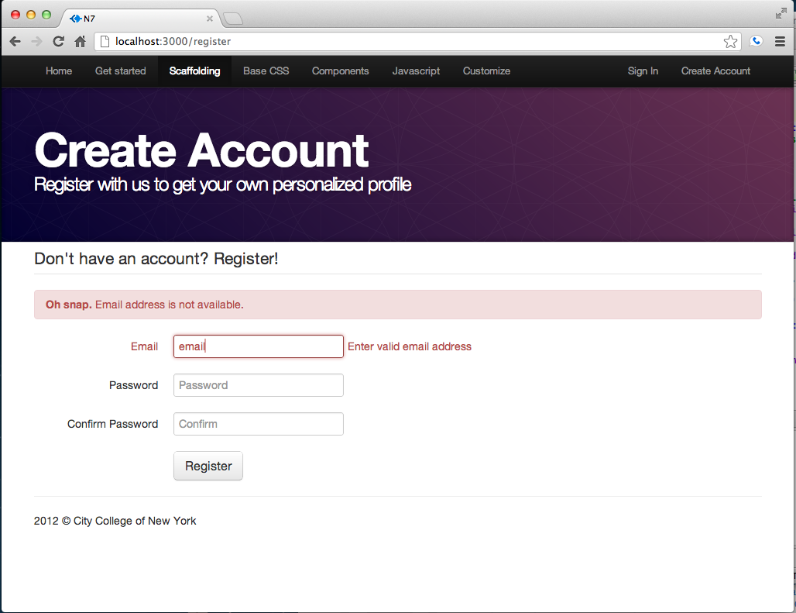
Screenshots
Input validation on client-side and server-side

Slide 7
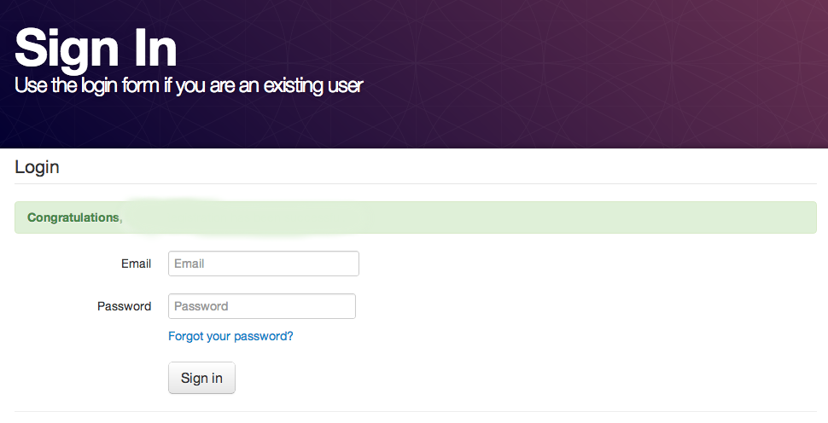
Screenshots
Nice alert message on login screen if registration has been successful

Slide 8
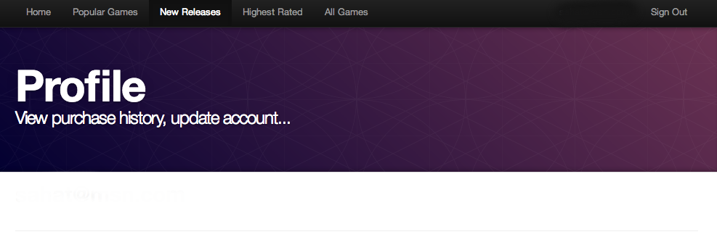
Screenshots
Profile view

Slide 9
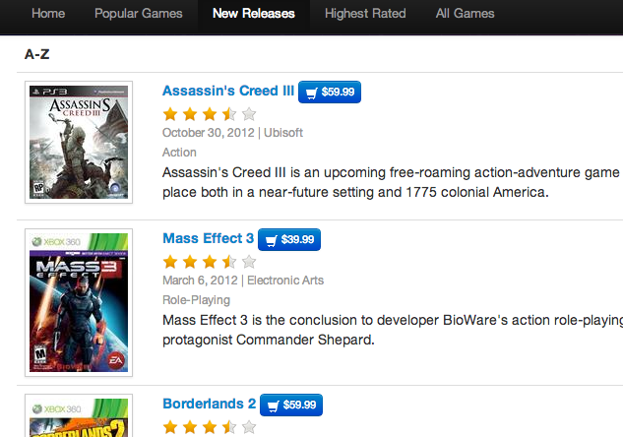
Screenshots
Game ratings retrieved from the database and displayed next to the game title

Slide 10
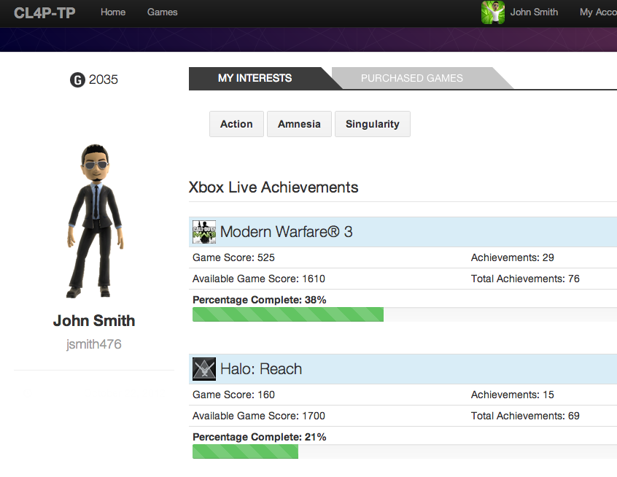
Screenshots
Xbox Live Achievements and User information for those who have a Gamertag

Slide 11
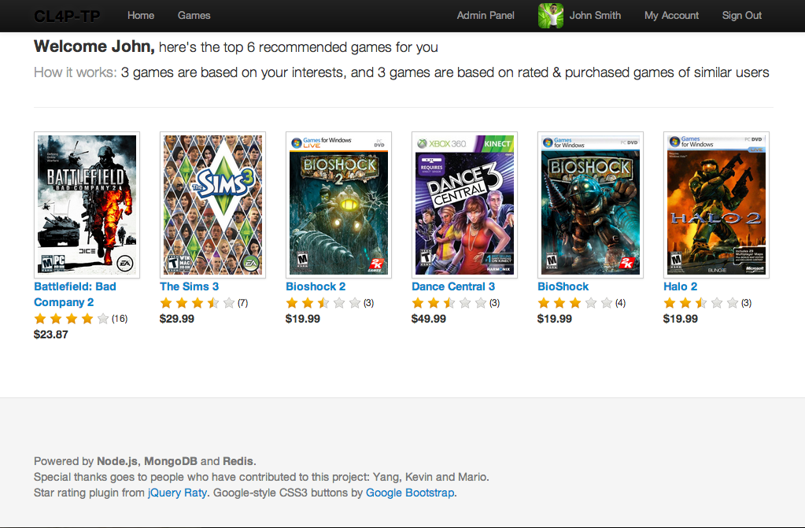

Screenshots
Recommendation Engine for registered users

